Slide 1
Energy Calculations
Salah Salah
Rotation PhD student
Dr. Amedee des Georges
May 3rd 2018

Slide 2
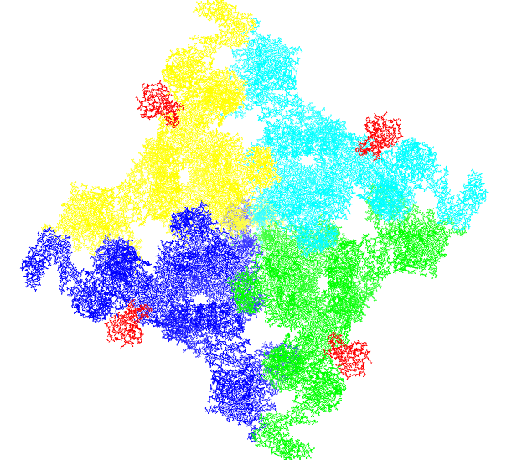
ryanodine receptor *
intracellular calcium (Ca2+) release channel
involved in skeletal muscle excitation-contraction coupling
Des Georges A, Clarke OB, Zalk R, et al. Structural basis for gating and activation of RyR1.
Cell. 2016;167(1):145-157.e17. doi:10.1016/j.cell.2016.08.075.

Slide 3
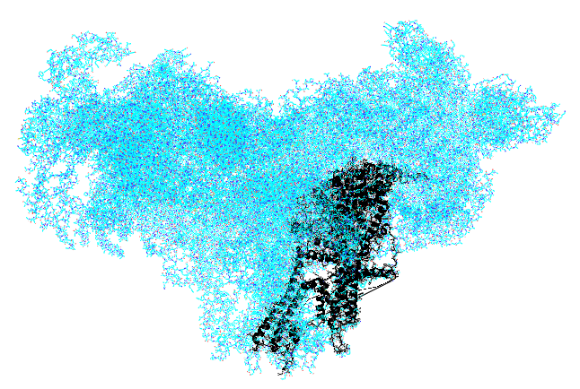
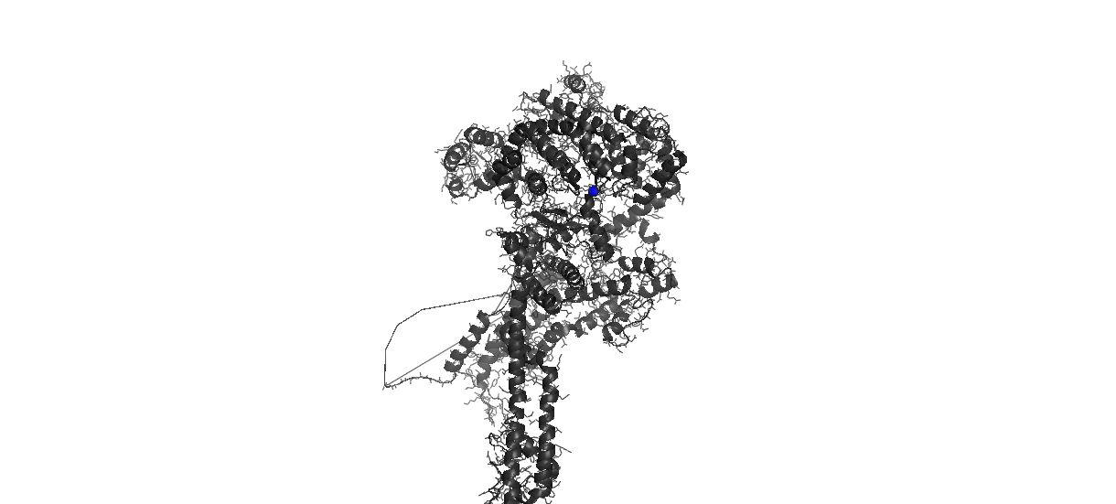
PDB id: 5t9v

Slide 4
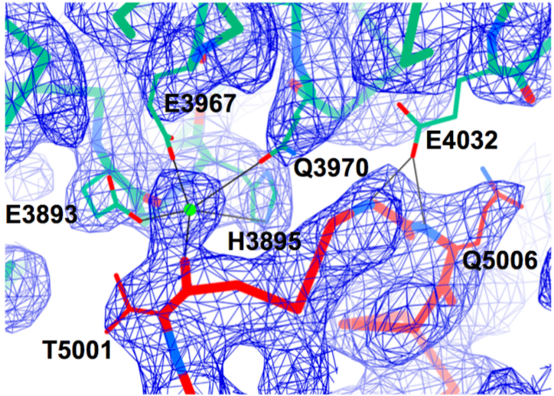
Ca2+-binding site
Des Georges A, Clarke OB, Zalk R, et al. Structural basis for gating and activation of RyR1. Cell. 2016;167(1):145-157.e17. doi:10.1016/j.cell.2016.08.075.

Slide 5
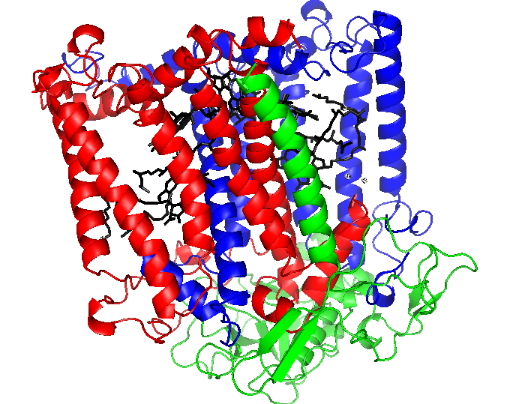

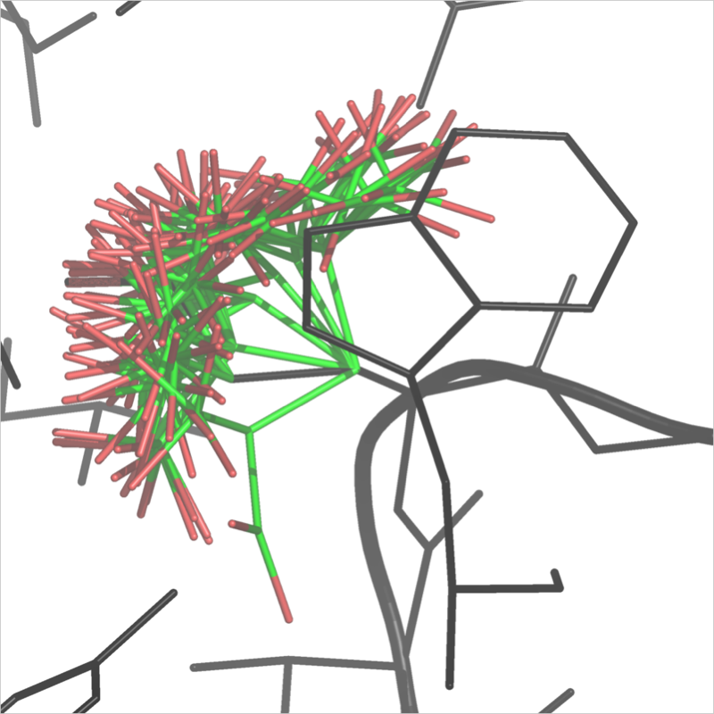
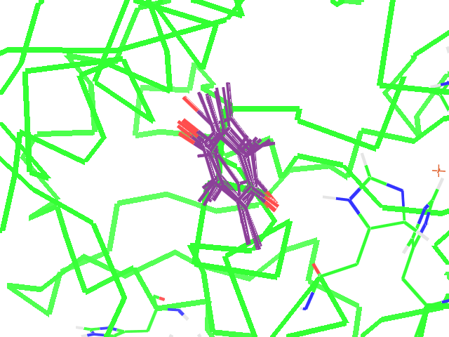
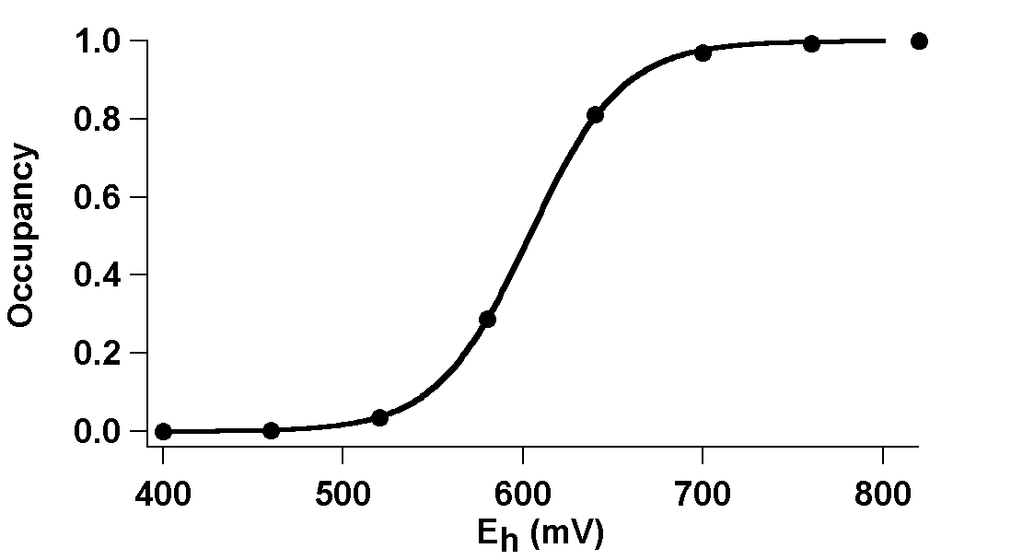
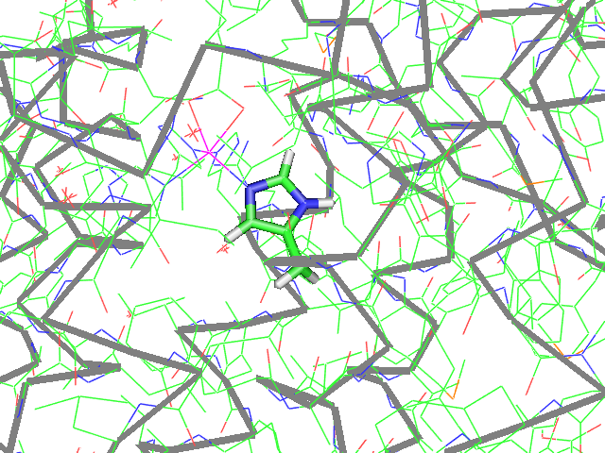
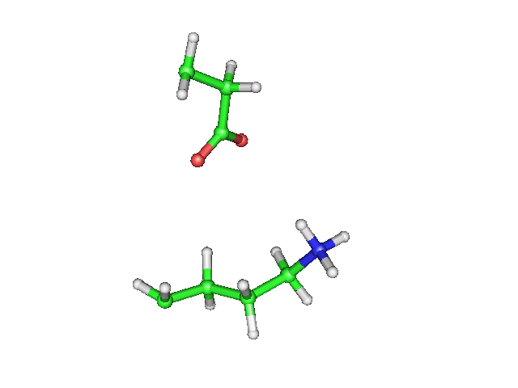
MCCE Method—Procedures
1. Use coordinates from PDB
2. Generate multiple conformers (side-chain positions and ionization states) for all residues and ligands
3. Set partial atomic charges and radii
4. Calculate a look-up table for SELF and PAIRWISE energies
5. MC sampling at different pH/Eh/chemical pot
50% occ
E_{M,} pK_{A,} K_{D,}
PAIRWISE
SELF
chem pot

Slide 6
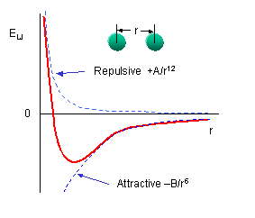
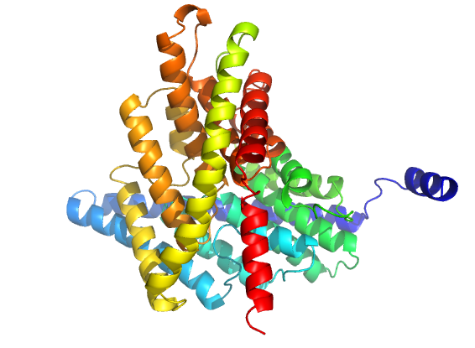
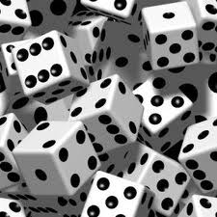
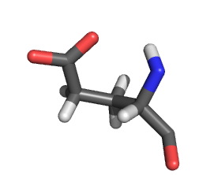
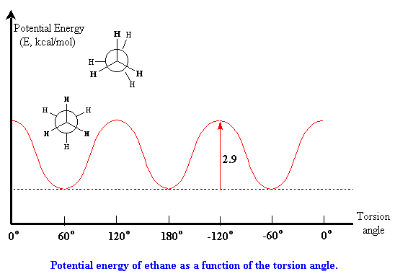
Multi-Conformation Continuum Electrostatics (MCCE)
Schematics of MCCE components:
ε = 80
PB
•
•
•
ε = 4
•
LJ
•
:
pK_{a} (or E_{m})
in protein
Monte Carlo sampling
xyz
Torsion
Sol. ref. pK_{a}
Song Y, Mao J, Gunner MR; MCCE2: Improving protein pKa calculations with extensive side chain rotamer sampling; J Comput Chem. (2009); 30:14, 2231–2247. doi:10.1002/jcc.21222
Alexov EG, Gunner MR; Incorporating protein conformational flexibility into the calculation of pH-dependent protein properties; Biophys J. (1997); 72;5, 2075–2093.

Slide 7
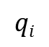
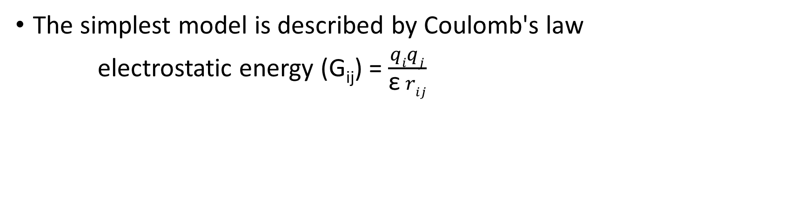
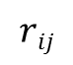
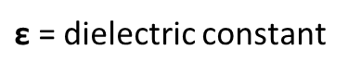
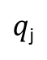
Electrostatic interactions
The simplest model is described by Coulomb's law
electrostatic energy (G_{ij}) = $\frac{qiqj}{\text{ε} rij}$
$$qi$$
$q$_{j}
$$rij$$
$\text{ε}$ = dielectric constant

Slide 8
Electrostatic interactions
The Poisson-Boltzmann equation arises because in some cases the charge density ρ depends on the potential φ
Poisson equation: the curvature of the electrostatic potential (φ) at a point in space is directly proportional
to the charge density (ρ) at that point and inversely proportional to the permittivity of the medium (ε)
E = - ∇φ
D = ε(r) E
∇ . D = −4πρ
∇²φ = (−4πρ)/ε
ρ = ρ_{int} + ρ_{ext}
(ρ_{int} is an interior charge distribution of the fixed positions of all charges in the molecule
ρ_{ext} is an exterior charge density, which accounts for the redistribution of ions in
solution in response to the electric potential in solution)
*Klapper, I.; Hagstrom, R.; Fine, R.; Sharp, K.; Honig, B. "Focusing of Electric Fields in the Active Site of Cu-Zn Superoxide Dismutase" Proteins 1, 47 (1986).

Slide 9
ρ_{ext} can be modeled by a Boltzmann distribution
∇²φ = (−4πρ)/ε
4πρ_{ext} = ε(r) k φ(r) [1 + φ²(r)/6 + φ⁴(r)/120 + …]
∇.[ε(r) ∇φ] - ε(r) k φ(r) [1 + φ²(r)/6 + φ⁴(r)/120 + …] + 4πρ_{int} = 0 (Poisson-Boltzmann equation)
http://hincklab.uthscsa.edu/html/soft_packs/msi_docs/insight980/delphi/02_Theory.doc.html

Slide 10
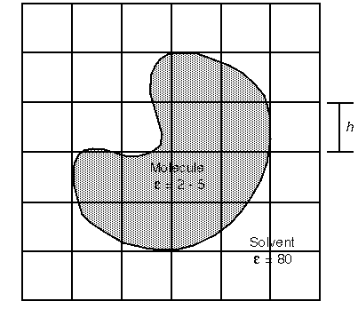
Finite Difference Approximation method is used to solve the Poisson-Boltzmann equation
Total Electrostatic Energy
G_{E} = ½ ∑_{i} q_{i} * Φ(r)_{i}
Reaction Field Energy
G_{R} = ½ ∑_{i} ∑_{j} ẟ_{I} q_{j} / 𝝴_{s} r_{ij}
i = number of surface charges
j = number of real charges
ẟ_{i} = ith surface charge
q_{j} = jth real charge
𝝴_{s} = solute dielectric
r_{ij} = distance between i and qj (angstroms)
Two-dimensional mapping of molecule on delphi grid
*Klapper, I.; Hagstrom, R.; Fine, R.; Sharp, K.; Honig, B.
"Focusing of Electric Fields in the Active Site of Cu-Zn Superoxide Dismutase" Proteins 1, 47 (1986).

Slide 11
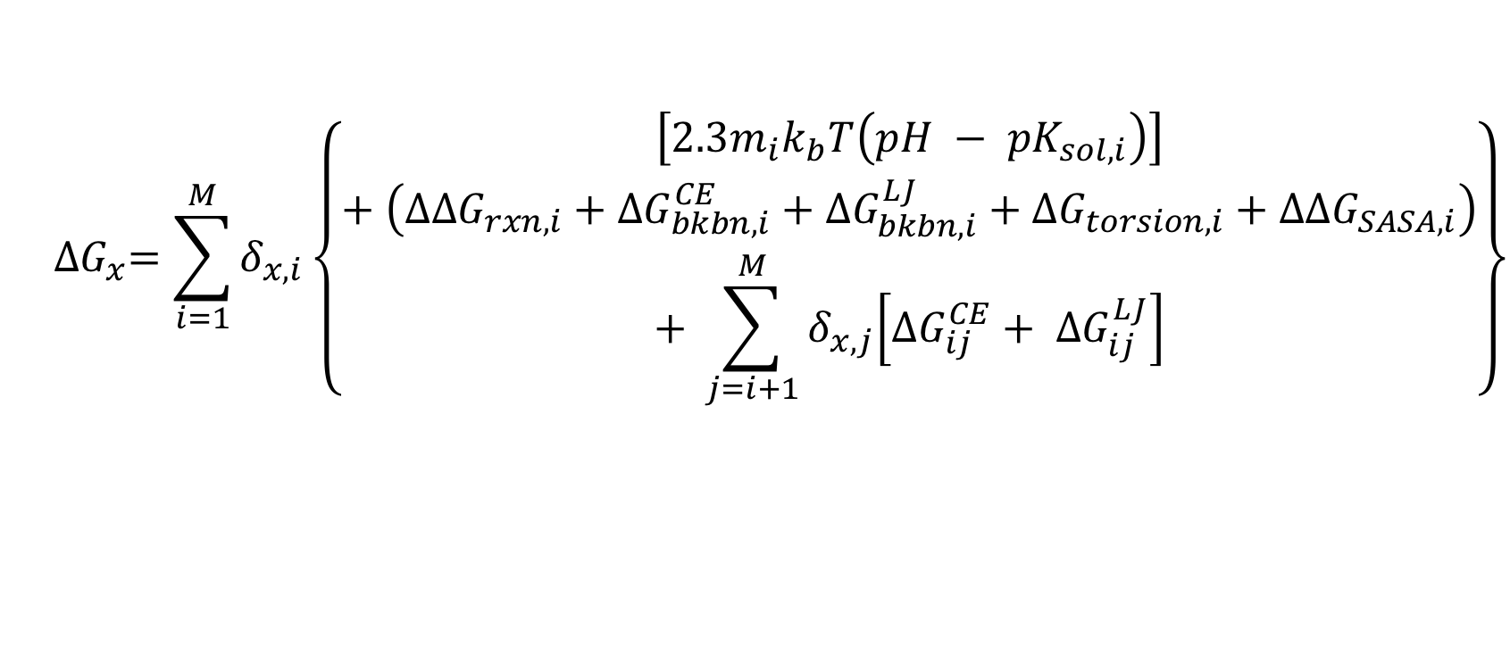
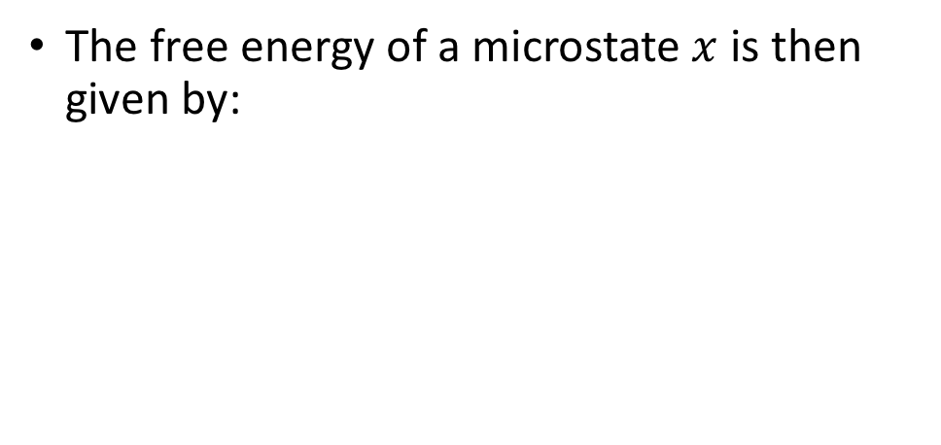
Revisiting MCCE microstate free energies
Equilibrium Ensemble
The free energy of a microstate $x$ is then given by:
Chemical potential
$${∆G}_{x}=\sum_{i=1}^{M}{δ_{x, i}\left\{\begin{aligned}\left[2.3m_{i}k_{b}T\left(pH − {pK}_{sol, i}\right)\right] \\ + \left({∆∆G}_{rxn, i}+{∆G}_{bkbn, i}^{CE}+{∆G}_{bkbn,i}^{LJ}+{∆G}_{torsion,i}+{∆∆G}_{SASA,i}\right) \\ + \sum_{j=i+1}^{M}{δ_{x,j}\left[{∆G}_{ij}^{CE}+ {∆G}_{ij}^{LJ}\right]}\end{aligned}\right\}}$$
Coupling terms

Slide 12
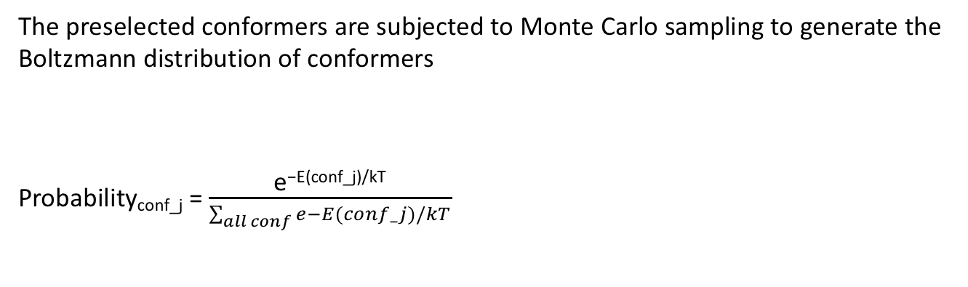
The preselected conformers are subjected to Monte Carlo sampling to generate the
Boltzmann distribution of conformers
Probability_{conf_j} = $\frac{\text{e}\text{−}\text{E}\text{(}\text{conf}\text{_}\text{j}\text{)/}\text{kT}}{\sum_{all conf}{e−E(conf_j)/kT}}$
The Boltzmann factor: fraction of the conf. with
Enough energy to make a jump
Equilibrium Ensemble

Slide 13
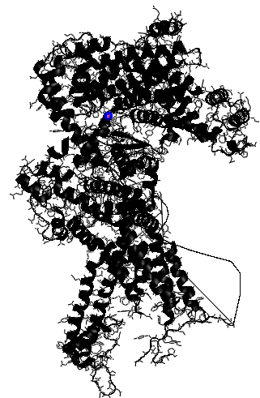
Frame 1
https://github.com/SalahBioPhysics

Slide 14
Things to consider:
The calculations were made only
on the a segment of the ryr1
ATP and CFF are not part of the
calculations because we don’t have
the charge and radii files
h2O is implicit (maybe we can use
WaterMap in the future
“https://github.com/kurtzmanlab/sstmap”)

